Slide 1



Database

Slide 2

TRADITIONALLY
In a daily life, we come across various needs to store data. It can be maintaining daily household bills, bank account details, salary details, payment details, student information, student reports, books in the library etc.
How it will be recorded at one place, so that we can get it back when required? It should be recorded in such a way that:
Should be able to get the data any point in time latter
Should be able to add details to it whenever required
Should be able to modify stored information, as needed
Should also be able to delete them
In traditional approach, before to computer, all information were stored in papers. When we need information, we used to search through the papers. How do we search for single required data in papers? It is a never ending task! Yes, Computers solved our problems.

Slide 3
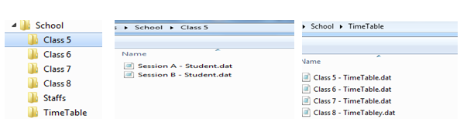
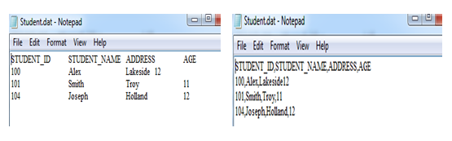
FILE PROCESSING SYSTEM
Now, if we want to see a specific Student detail from a file, what do we do? We know which file will have the data, we open that file and search for his details. Fine, here we see the files; we can open it and search for it.
But imagine we want to display student details in a UI. Now how will we open a file, read or update it? There different programs like C, C++, COBOL etc which helps to do this task. Using these programming languages, we can search for files, open them, search for the data inside them, and go to specific line in the file, add/update/delete specific information.

Slide 4
FILE SYSTEM-DISADVANTAGES
Data Mapping and Access: – Although all the related informations are grouped and stored in different files, there is no mapping between any two files. i.e.; any two dependent files are not linked. Even though Student files and Student_Report files are related, they are two different files and they are not linked by any means. Hence if we need to display student details along with his report, we cannot directly pick from those two files. We have to write a lengthy program to search Student file first, get all details, then go Student_Report file and search for his report.When there is very huge amount of data, it is always a time consuming task to search for particular information from the file system. It is always an inefficient method to search for the data
Data Redundancy: – There are no methods to validate the insertion of duplicate data in file system. Any user can enter any data. File system does not validate for the kind of data being entered nor does it validate for previous existence of the same data in the same file. Duplicate data in the system is not appreciated as it is a waste of space, and always lead to confusion and mishandling of data. When there are duplicate data in the file, and if we need to update or delete the record, we might end up in updating/deleting one of the record, leaving the other record in the file. Again the file system does not validate this process. Hence the purpose of storing the data is lost.Though the file name says Student file, there is a chance of entering staff information or his report information in the file. File system allows any information to be entered into any file. It does not isolate the data being entered from the group it belongs to.

Slide 5
FILE SYSTEM-DISADVANTAGES
Data Dependence: – In the files, data are stored in specific format, say tab, comma or semicolon. If the format of any of the file is changed, then the program for processing this file needs to be changed. But there would be many programs dependent on this file. We need to know in advance all the programs which are using this file and change in the entire place. Missing to change in any one place will fail whole application. Similarly, changes in storage structure, or accessing the data, affect all the places where this file is being used. We have to change it entire programs. That is smallest change in the file affect all the programs and need changes in all them.
Data inconsistency: – Imagine Student and Student_Report files have student’s address in it, and there was a change request for one particular student’s address. The program searched only Student file for the address and it updated it correctly. There is another program which prints the student’s report and mails it to the address mentioned in the Student_Report file. What happens to the report of a student whose address is being changed? There is a mismatch in the actual address and his report is sent to his old address. This mismatch in different copies of same data is called data inconsistency.

Slide 6
FILE SYSTEM-DISADVANTAGES
Data Isolation: – Imagine we have to generate a single report of student, who is studying in particular class, his study report, his library book details, and hostel information. All these informations are stored in different files. How do we get all these details in one report? We have to write a program. But before writing the program, the programmer should find out which all files have the information needed, what is the format of each file, how to search data in each file etc. Once all these analysis is done, he writes a program. If there is 2-3 files involved, programming would be bit simple. Imagine if there is lot many files involved in it? It would be require lot of effort from the programmer. Since all the datas are isolated from each other in different files, programming becomes difficult.
Security: – Each file can be password protected. But what if have to give access to only few records in the file? For example, user has to be given access to view only their bank account information in the file. This is very difficult in the file system.
Integrity: – If we need to check for certain insertion criteria while entering the data into file it is not possible directly. We can do it writing programs. Say, if we have to restrict the students above age 18, then it is by means of program alone. There is no direct checking facility in the file system. Hence these kinds of integrity checks are not easy in file system.

Slide 7
FILE SYSTEM-DISADVANTAGES
Atomicity: – If there is any failure to insert, update or delete in the file system, there is no mechanism to switch back to the previous state. Imagine marks for one particular subject needs to be entered into the Report file and then total needs to be calculated. But after entering the new marks, file is closed without saving.
Concurrent Access: – Accessing the same data from the same file is called concurrent access. In the file system, concurrent access leads to incorrect data. For example, a student wants to borrow a book from the library. He searches for the book in the library file and sees that only one copy is available.

Slide 8
DBMS
" data means known facts that can be recorded and have implicit meanings. “It can be used in a variety of forms like text, numbers, media, bytes, etc.
We define a database as an organised collection of logically related data which is used to retrieve, insert and delete the data efficiently.
database represents some aspect of the real word.
For example ,consider data of a bank accounts. here,all the data - id,name,address,contact no - interrelated.so,they represent some particular customer.
A database management system is a collection of inter-related data and a set of programs to manipulate those data.
DBMS = Database + Set of programs
database management system stores data in such a way that it becomes easier to retrieve, manipulate, and produce information.
DBMS provides an interface to perform various operations like database creation, storing data in it, updating data, creating a table in the database and a lot more.
It also provide security or safety against system crashes. In the case of multiple users, it also maintains data consistency.

Slide 9
Database-characteristics
Should be able to store all kinds of data that exists in this real world (real world entity)
Should be able to relate the entities / tables in the database by means of a relation. i.e.; any two tables should be related (relational)
Data and application should be isolated.
There should not be any duplication of data in the database (less redundancy)
DBMS has a strong query language. Once the database is designed, this helps the user to retrieve and manipulate the data (query language)
Multiple users should be able to access the same database, without affecting the other user.
It supports multiple views to the user, depending on his role
Database should also provide security,
Database should also support ACID property

Slide 10
Database-disadvantages
SIZE: It occupies large disk space and large memory to run efficiently.
COST: Database systems require sophisticated hardware and software and highly skilled personnel. The cost of maintaining the hardware, software, and personnel required to operate and manage a database system can be substantial. Training, licensing, and regulation compliance costs are often overlooked when database systems are implemented.
COMPLEXITY: Database systems interface with many different technologies and have a significant impact on a company’s resources and culture.
FREQUENT UPDATE: DBMS vendors frequently upgrade their products by adding new functionality. Such new features often come bundled in new upgrade versions of the software.
Some of these versions require hardware upgrades. Not only do the upgrades themselves cost money, but it also costs money to train database users and administrators to properly use and manage the new features.

Slide 11

DBMS-ARCHITECTURE-1-TIER
In this architecture, the database is directly available to the user. It means the user can directly sit on the DBMS and uses it.
The simplest of Database Architecture are 1 tier where the Client, Server, and Database all reside on the same machine. Anytime you install a DB in your system and access it to practiCe SQL queries it is 1 tier architecture. But such architecture is rarely used in production.

Slide 12
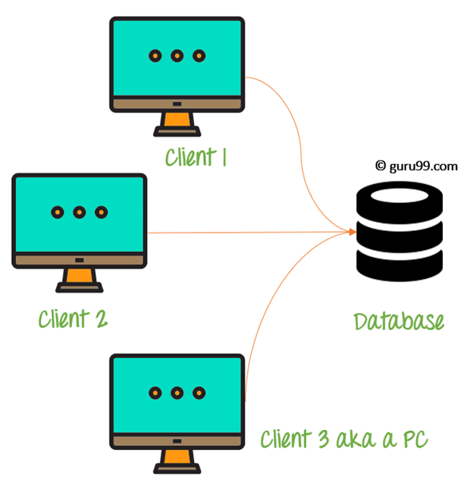
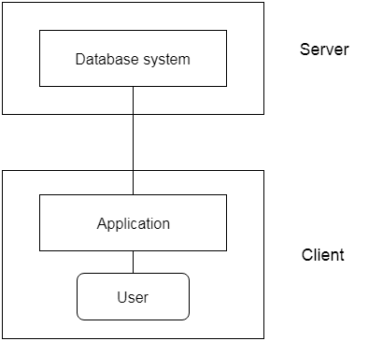
DBMS-ARCHITECTURE-2-TIER
The 2-Tier architecture is same as basic client-server. In the two-tier architecture, applications on the client end can directly communicate with the database at the server side. For this interaction, API's like: ODBC, JDBC are used.
The user interfaces and application programs are run on the client-side.
The server side is responsible to provide the functionalities like: query processing and transaction management.
To communicate with the DBMS, client-side application establishes a connection with the server side.
2 tier architecture provides added security to the DBMS as it is not exposed to the end user directly.

Slide 13
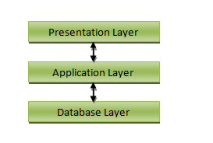
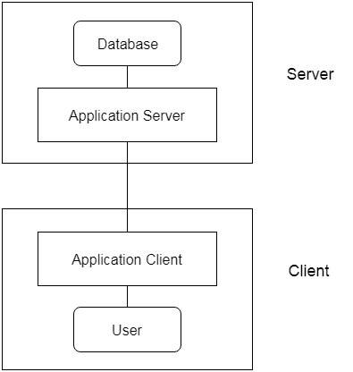
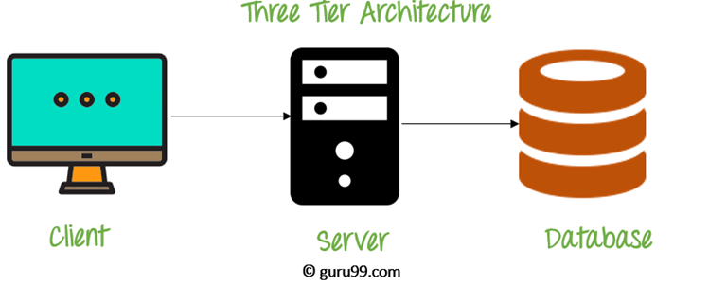
DBMS-ARCHITECTURE-3-TIER
3-tier schema is an extension of the 2-tier architecture
The 3-Tier architecture contains another layer between the client and server. In this architecture, client can't directly communicate with the server.
The application on the client-end interacts with an application server which further communicates with the database system.
The application layer(business logic layer) also processes functional logic, constraint, and rules before passing data to the user or down to the DBMS

Slide 14
DBMS-ARCHITECTURE-3-TIER
Presentation layer / User layer is the layer where user uses the database. He does not have any knowledge about underlying database. He simply interacts with the database as though he has all data in front of him. You can imagine this layer as a registration form where you will be inputting your details. Did you ever guessed, after pressing ‘submit’ button where the data goes? No right? You just know that your details are saved. This is the presentation layer where all the details from the user are taken, sent to the next layer for processing.
Application layer is the underlying program which is responsible for saving the details that you have entered, and retrieving your details to show up in the page. This layer has all the business logics like validation, calculations and manipulations of data, and then sends the requests to database to get the actual data. If this layer sees that the request is invalid, it sends back the message to presentation layer. It will not hit the database layer at all.
Data layer or Database layer is the layer where actual database resides. In this layer, all the tables, their mappings and the actual data present. When you save you details from the front end, it will be inserted into the respective tables in the database layer, by using the programs in the application layer. When you want to view your details in the web browser, a request is sent to database layer by application layer. The database layer fires queries and gets the data. These data are then transferred to the browser (presentation layer) by the programs in the application layer.

Slide 15
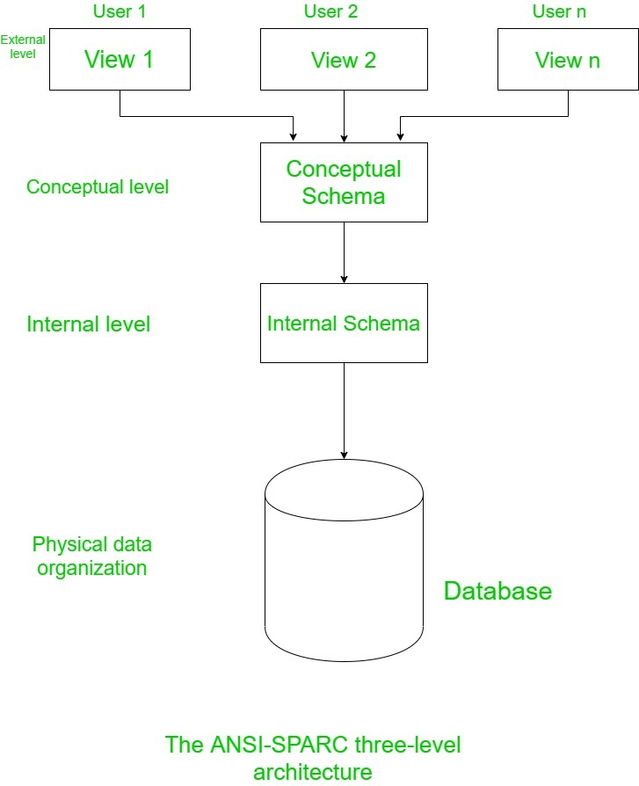
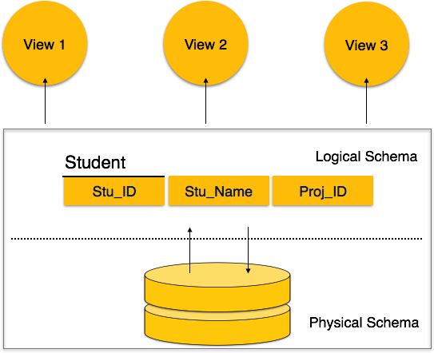
ANSI SPARC-3-TIER ARCHITECTURE

Slide 16
ANSI SPARC-3-TIER ARCHITECTURE
Internal level:
This is the lowest level of data abstraction.
It describes How the data are actually stored on storage devices.
It is also known as physical level.
It provides internal view of physical storage of data.
It deals with complex low level data structures,file structures and access methods in detail.
It also deals with Data Compression and Encryption techniques,if used.

Slide 17
ANSI SPARC-3-TIER ARCHITECTURE
Conceptual level:
This is the next higher level than internal level of data abstraction.
It describes What data are stored in the database and What relationships exist among those data.
It is also known as Logical level.
It hides low level complexities of physical storage.
Database administrator and designers work at this level to determine What data to keep in database.
Application developers also work on this level.

Slide 18
ANSI SPARC-3-TIER ARCHITECTURE
External Level:
This is the highest level of data abstraction.
It describes only part of the entire database that a end user concern.
It is also known as a view level.
End users need to access only part of the database rather than entire database.
Different user need different views of database. And so, there can be many view level abstractions of the same database.

Slide 19
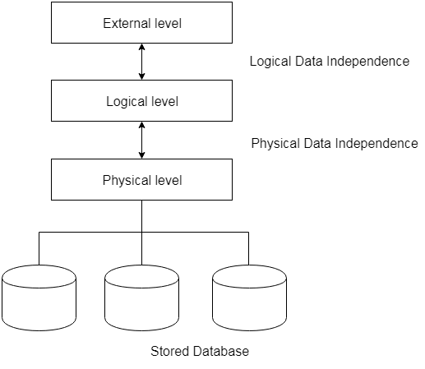
DATA INDEPENDENCE
Data independence can be explained using the three-schema architecture.
Data independence refers characteristic of being able to modify the schema at one level of the database system without altering the schema at the next higher level.
There are two types of data independence:
Logical Data Independence
Physical Data Independence

Slide 20
DATA INDEPENDENCE
Physical level data independence : It refers to the characteristic of being able to modify the physical schema without any alterations to the conceptual or logical schema, done for optimisation purposes, e.g., Conceptual structure of the database would not be affected by any change in storage size of the database system server
Logical level data independence: It refers characteristic of being able to modify the logical schema without affecting the external schema or application program. The user view of the data would not be affected by any changes to the conceptual view of the data. These changes may include insertion or deletion of attributes, altering table structures entities or relationships to the logical schema etc.

Slide 21
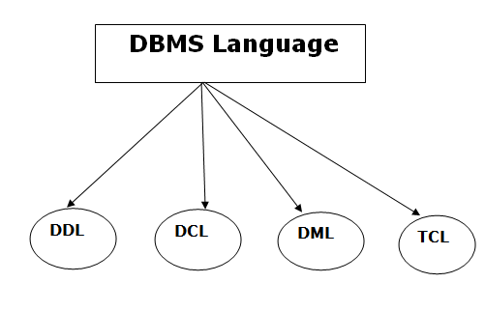
Dbms language

Slide 22
Data Definition Language
DDL stands for Data Definition Language. It is used to define database structure or pattern.
It is used to create schema, tables, indexes, constraints, etc. in the database.
Using the DDL statements, you can create the skeleton of the database.
Here are some tasks that come under DDL:
Create: It is used to create objects in the database.
Alter: It is used to alter the structure of the database.
Drop: It is used to delete objects from the database.
Truncate: It is used to remove all records from a table.
Rename: It is used to rename an object.

Slide 23
Data Manipulation Language
DML stands for Data Manipulation Language. It is used for accessing and manipulating data in a database. It handles user requests.
Here are some tasks that come under DML:
Select: It is used to retrieve data from a database.
Insert: It is used to insert data into a table.
Update: It is used to update existing data within a table.
Delete: It is used to delete all records from a table.
Merge: It performs UPSERT operation, i.e., insert or update operations.

Slide 24
Data Control Language
DCL stands for Data Control Language
It is used to create roles, permissions, and referential integrity as well it is used to control access to database by securing it.
GRANT – Gives user's access privileges to database
REVOKE – Withdraws user's access privileges to database given with the GRANT command

Slide 25
Transaction Control Language
It is used to manage different transactions occurring within a database.
COMMIT – Saves work done in transactions ROLLBACK – Restores database to original state since the last COMMIT command in transactions SAVE TRANSACTION – Sets a savepoint within a transaction

Slide 26
Data models
Data models define how the logical structure of a database is modeled
Data Model gives us an idea that how the final system will look like after its complete implementation.
It defines the data elements and the relationships between the data elements.
Data Models are used to show how data is stored, connected, accessed and updated in the database management system
Here, we use a set of symbols and text to represent the information so that members of the organisation can communicate and understand it

Slide 27
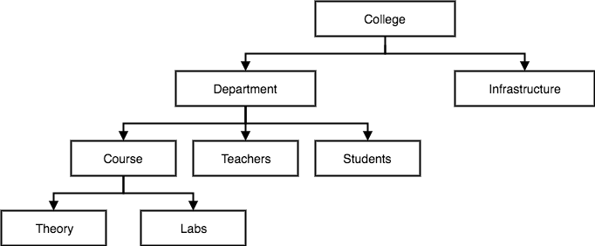
Hierarchical Model
This database model organises data into a tree-like-structure, with a single root, to which all the other data is linked. The heirarchy starts from the Root data, and expands like a tree, adding child nodes to the parent nodes.
In this model, a child node will only have a single parent node.

Slide 28
Hierarchical
Pros & Cons
It is very simple and fast to traverse through a tree-like structure.
Any change in the parent node is automatically reflected in the child node so, the integrity of data is maintained.
Complex relationships are not supported.
As it does not support more than one parent of the child node so if we have some complex relationship where a child node needs to have two parent node then that can't be represented using this model.
If a parent node is deleted then the child node is automatically deleted.

Slide 29
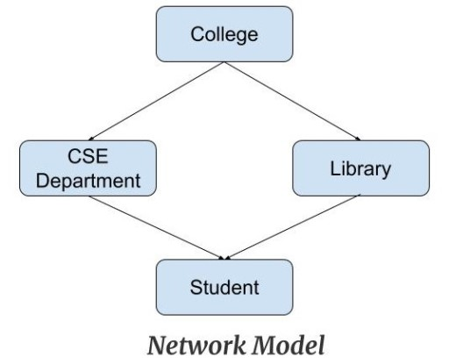
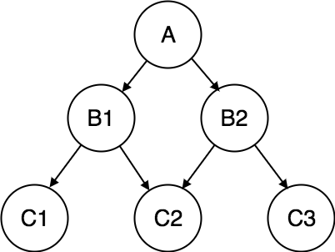
network Model
This is an extension of the Hierarchical model. In this model data is organised more like a graph, and are allowed to have more than one parent node
In this database model data is more related as more relationships are established in this database model.
Also, as the data is more related, hence accessing the data is also easier and fast. This database model was used to map many-to-many data relationships.

Slide 30
Network
Pros & Cons
As there are more relationships so there can be more than one path to the same record. This makes data access fast and simple.
In this model, as there are more relationships so data is more related. This model has the ability to manage one-to-one relationships as well as many-to-many relationships
As there is a parent-child relationship so data integrity is present. Any change in parent record is reflected in the child record.
As more and more relationships need to be handled the system might get complex. So, a user must be having detailed knowledge of the model to work with the model.
Any change like updation, deletion, insertion is very complex.

Slide 31
Entity-relationship Model
It develops a conceptual design for the database. It also develops a very simple and easy to design view of data
An ER model is a design or blueprint of a database that can later be implemented as a database.
An ER diagram shows the relationship among entity sets
An entity set is a group of similar entities and these entities can have attributes
It is a high-level data model. This model is used to define the data elements and relationship for a specified system.

Slide 32
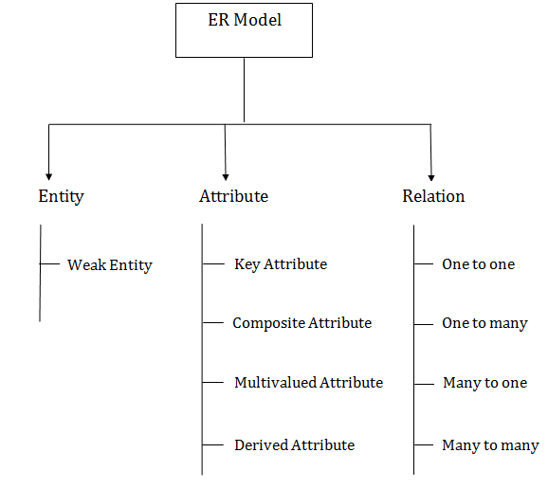
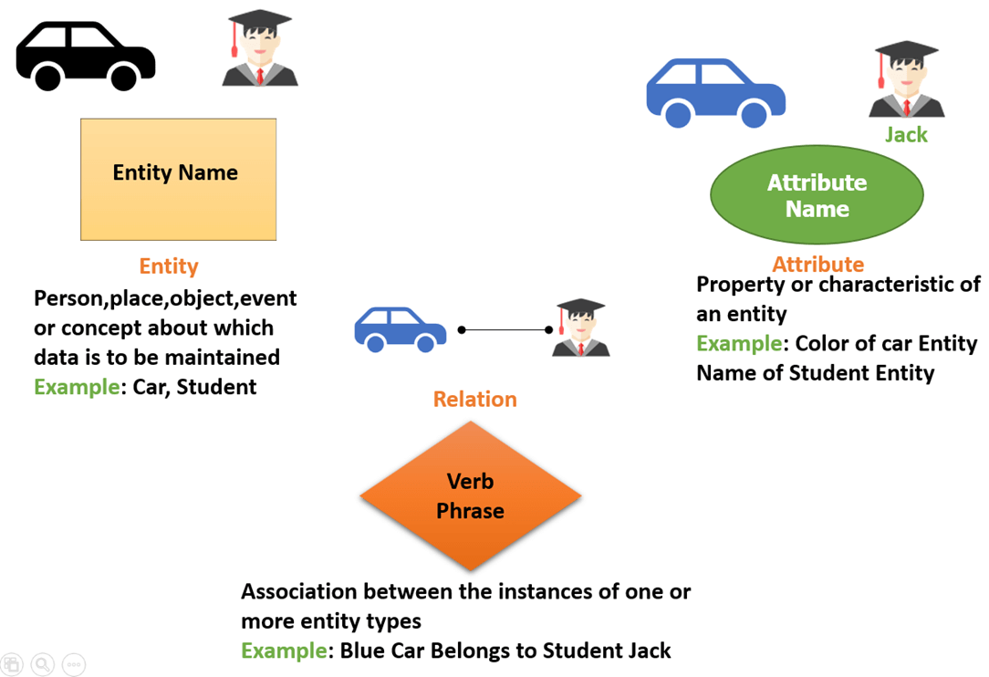
ER DIAGRAM-COMPONENTS

Slide 33
ER-ENTITY
An entity can be place, person, object, event or a concept, which stores data in the database
In the ER diagram, an entity can be represented as rectangles.
It is anything in the enterprise that is to be represented in our database. It may be a physical thing or simply a fact about the enterprise or an event that happens in the real world.
Every entity is made up of some 'attributes' which represent that entity.
For example, a student entity may have a name, age, class, as attributes.
Examples of entities:
Person: Employee, Student, Patient
Place: Store, Building
Object: Machine, product, and Car
Event: Sale, Registration, Renewal
Concept: Account, Course

Slide 34
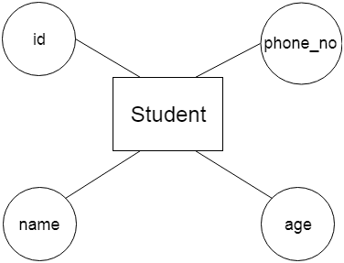
ER-ATTRIBUTES
The attribute is used to describe the property of an entity. Eclipse is used to represent an attribute.
For example, id, age, contact number, name, etc. can be attributes of a student.

Slide 35
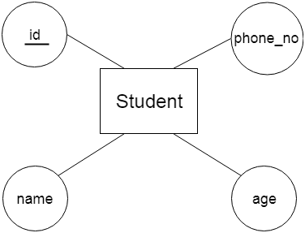
KEY ATTRIBUTE
A key attribute can uniquely identify an entity from an entity set.
For example, student roll number (ID) can uniquely identify a student from a set of students.
Key attribute is represented by oval same as other attributes however the text of key attribute is underlined.

Slide 36
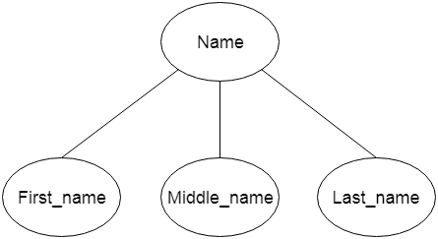
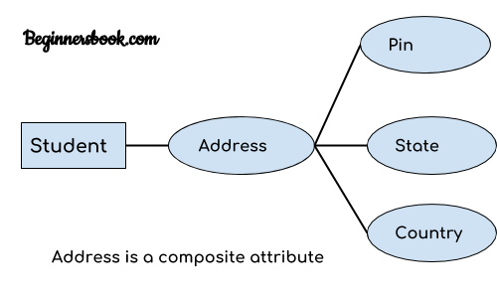
COMPOSITE ATTRIBUTE
An attribute that composed of many other attributes is known as a composite attribute.
The composite attribute is represented by an ellipse, and those ellipses are connected with an ellipse.
For example, In student entity, the student address is a composite attribute as an address is composed of other attributes such as pin code, state, country.

Slide 37
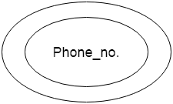
MULTIVALUED ATTRIBUTE
An attribute can have more than one value. These attributes are known as a multivalued attribute.
The double oval is used to represent multivalued attribute.
For example – A person can have more than one phone numbers so the phone number attribute is multivalued.

Slide 38
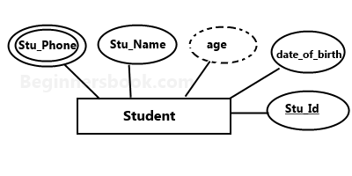
DERIVED ATTRIBUTE
An attribute that can be derived from other attribute is known as a derived attribute.
It can be represented by a dashed ellipse.
For example – Person age is a derived attribute as it changes over time and can be derived from another attribute (Date of birth).

Slide 39
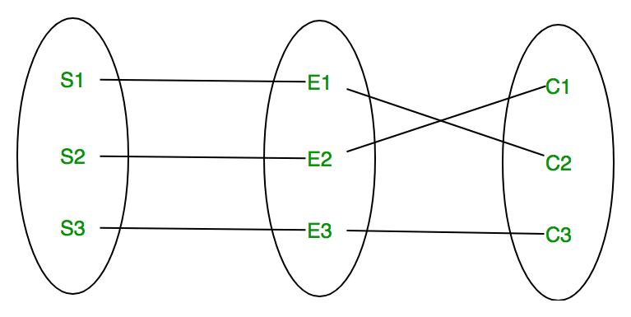
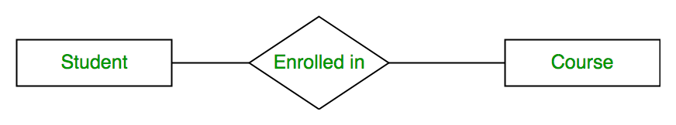
RELATIONSHIP
A relationship is represented by diamond shape
in ER diagram, it shows the relationship among entities. There are four types of relationships:
A relationship type represents the association between entity types
For example,‘Enrolled in’ is a relationship type that exists between entity type Student and Course
A set of relationships of same type is known as relationship set. The following relationship set depicts S1 is enrolled in C2, S2 is enrolled in C1 and S3 is enrolled in C3.

Slide 40
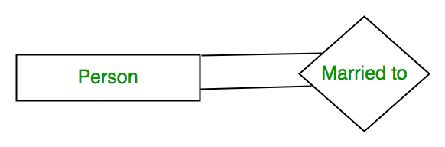
Degree of a relationship set:
The number of different entity sets participating in a relationship set is called as degree of a relationship set.
Unary Relationship – When there is only ONE entity set participating in a relation, the relationship is called as unary relationship. For example, one person is married to only one person.
Binary Relationship – When there are TWO entities set participating in a relation, the relationship is called as binary relationship.For example, Student is enrolled in Course.
n-ary Relationship – When there are n entities set participating in a relation, the relationship is called as n-ary relationship.

Slide 41
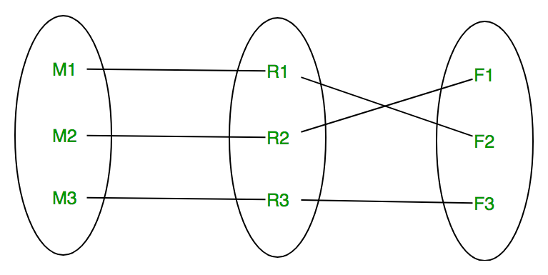
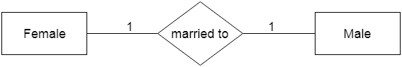
Cardinality
The number of times an entity of an entity set participates in a relationship set is known as cardinality
One to one – When each entity in each entity set can take part only once in the relationship, the cardinality is one to one.
One entity from entity set X can be associated with at most one entity of entity set Y and vice versa.
For example, a person has only one passport and a passport is given to one person.
For example, A female can marry to one male, and a male can marry to one female.

Slide 42
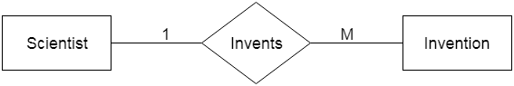
CARDINALITY-One-to-many
When only one instance of the entity on the left, and more than one instance of an entity on the right associates with the relationship then this is known as a one-to-many relationship.
One entity from entity set X can be associated with multiple entities of entity set Y, but an entity from entity set Y can be associated with at MOST one entity.
For example, one class is consisting of multiple students.
For example, Scientist can invent many inventions, but the invention is done by the only specific scientist.

Slide 43
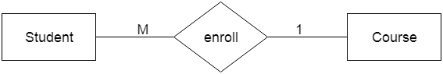
CARDINALITY-MANY TO ONE
When more than one instance of the entity on the left, and only one instance of an entity on the right associates with the relationship then it is known as a many-to-one relationship.
Let us assume that a student can take only one course but one course can be taken by many students. So the cardinality will be n to 1. It means that for one course there can be n students but for one student, there will be only one course.

Slide 44
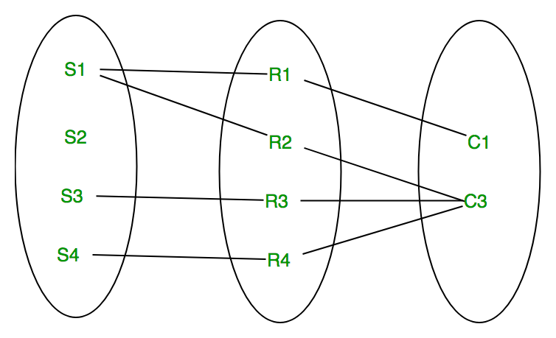
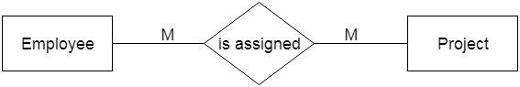
CARDINALITY-MANY TO MANY
When more than one instance of the entity on the left, and more than one instance of an entity on the right associates with the relationship then it is known as a many-to-many relationship.
One entity from X can be associated with more than one entity from Y and vice versa.
For example, Employee can assign by many projects and project can have many employees.

Slide 45
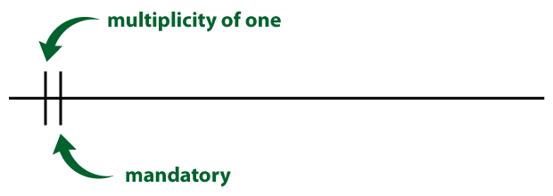
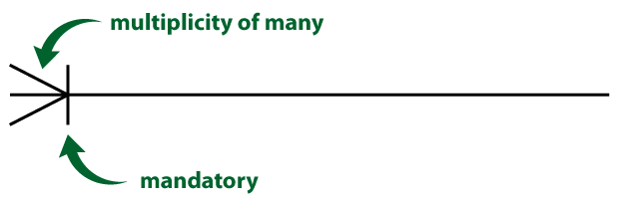
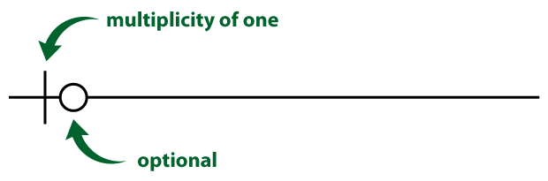
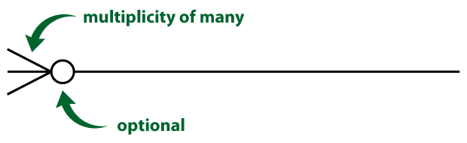
Crow feet notation

Slide 46
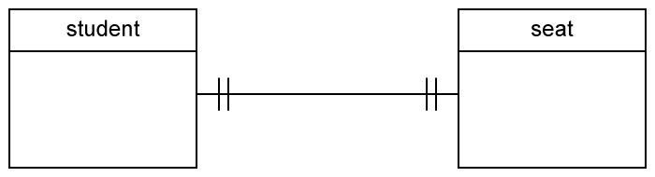
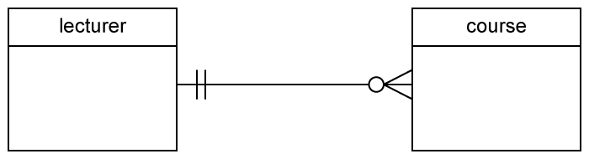
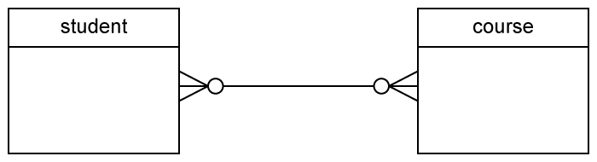
Crow feet

Slide 47
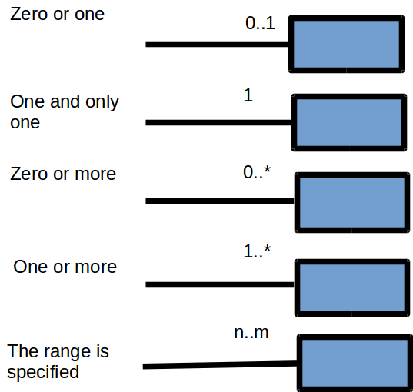
Uml notation

Slide 48
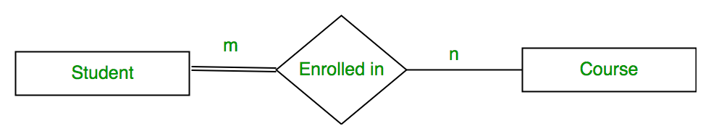
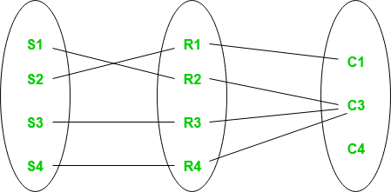

Participation constraints
An entity set may participate in a relation either totally or partially.
Total participation means that every entity in the set is involved in the relationship, e.g., each student must be guided by a professor (there are no students who are not guided by any professor). In the Chen notation, this kind of relation is depicted as a double line.
Partial participation means that not all entities in the set are involved in the relationship, e.g., not every professor guides a student (there are professors who don’t). In the Chen notation, a partial participation is represented by a single line.

Slide 49
Steps to Create an ERD
Let us create a simple ER diagram for a STUDENT database. What is the requirement of this database?
‘Student attends class. Each class is divided into one or more sections. Each class will have its own specified subjects. Students have to attend all the subjects of the class that he attends’.
Step 1) Entity Identification
STUDENT, CLASS, SECTION, SUBJECT are the entities.
Step 2) IDENTIFY ATTRIBUTES
Student(student_id,student_name,address,dob,age,class_id,section_id)
CLASS(CLASS_ID,CLASS_NAME)
SECTION(SECTION_ID,SECTION_NAME)
SUBJECT(SUBJECT_ID,SUBJECT_NAME)

Slide 50
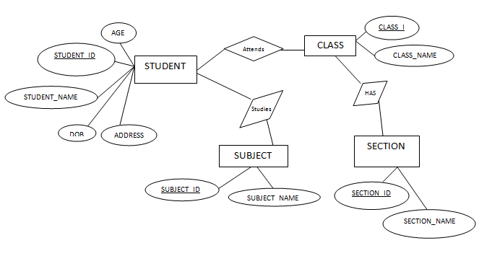
Steps to Create an ERD
STEP 3) identify relationships
What are the relationships we have? ‘Attends’, ‘has section’, ‘have subjects’ and ‘studies subjects’ are the relations here
Step 4) cardinality identification
Step 5) draw erd

Slide 51
What are the participation constraints here?
All the Students attend any one of the class, but class can have only certain group of students. Hence total participation of Students and partial participation of class in ‘Attends’ relation.
All the class has section and all the section has class. Hence both are total participation.
All the Students study some of the subjects specific for their class and each class has only some group of subjects. Hence partial participation of both STUDENT and CLASS. Each subject will be studied by some students and it will be part of some class. Hence this also partial participation.

Slide 52
What are the cardinalities of all the relationship?
Each Student attends only one class at a time. Hence it is a 1: 1 relation.
Each class has one or more sections. Hence it can be considered as 1: N relation.
Each student attends many subjects and each class has many subjects. Hence it is a 1:Nrelation.

Slide 53
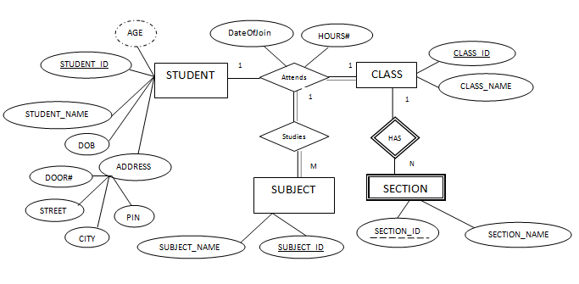

Slide 54
ERD
Step 1) Entity Identification
We have three entities
Student
Course
Professor
Let's study them with an example:
In a university, a Student enrolls in Courses. A student must be assigned to at least one or more Courses. Each course is taught by a single Professor.
To maintain instruction quality, a Professor can deliver only one course
Step 2) Relationship Identification
We have the following two relationships
The student is assigned a course
Professor delivers a course
Step 4) Identify Attributes
STUDENT: STUDENT_ID,STUDENT_NAME PROFESSOR: EMPLOYEE_ID,PROFESSOR_NAME COURSE:COUSE_ID,COURSENAME
Step 3) Cardinality Identification
For them problem statement we know that,
A student can be assigned multiple courses
A Professor can deliver only one course

Slide 55
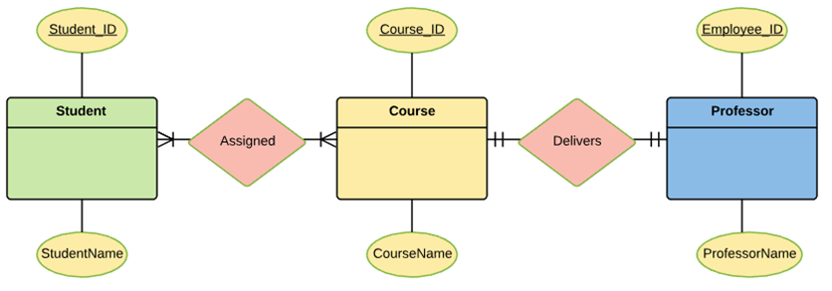
5) CREATE ERD

Slide 56
STRONG ENTITY
The Strong Entity is the one whose existence does not depend on the existence of any other entity in a schema.
It is denoted by a single rectangle
A strong entity always has the primary key in the set of attributes that describes the strong entity
It indicates that each entity in a strong entity set can be uniquely identified.
Set of similar types of strong entities together forms the Strong Entity Set
A strong entity holds the relationship with the weak entity via an Identifying Relationship, which is denoted by double diamond in the ER diagram.
On the other hands, the relationship between two strong entities is denoted by a single diamond and it is simply called as a relationship.

Slide 57
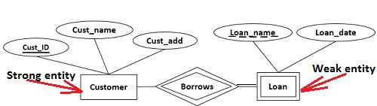
Strong-weak-entity-example
Let us understand this concept with the help of an example; a customer borrows a loan. Here we have two entities first a customer entity, and second a loan entity.
Observing the ER-diagram above, for each loan, there should be at least one borrower otherwise that loan would not be listed in Loan entity set. But even if a customer does not borrow any loan it would be listed in Customer entity set. So we can conclude that a customer entity does not depend on a loan entity.
The second thing you can observe that the Customer entity has as primary key Cust_ID which uniquely identify each entity in Customer Entity set. This makes Customer entity a strong entity on which a loan entity depends.

Slide 58
Weak entity
A Weak entity is the one that depends on its owner entity i.e. a strong entity for its existence.
A weak entity is denoted by the double rectangle.
Weak entity do not have the primary key instead it has a partial key that uniquely discriminates the weak entities.
The primary key of a weak entity is a composite key formed from the primary key of the strong entity and partial key of the weak entity.
The collection of similar weak entities is called Weak Entity Set
The relationship between a weak entity and a strong entity is always denoted with an Identifying Relationship i.e. double diamond.

Slide 59
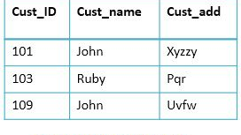
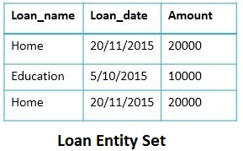
entity
In the Loan entity set, we have two exactly same entities i.e. a Home loan on date 20/11/2015 with amount 20000.
Now how to identify who had borrowed them this can be done with the help of primary key of the weak entity (Loan_name + Cust_ID)

Slide 60
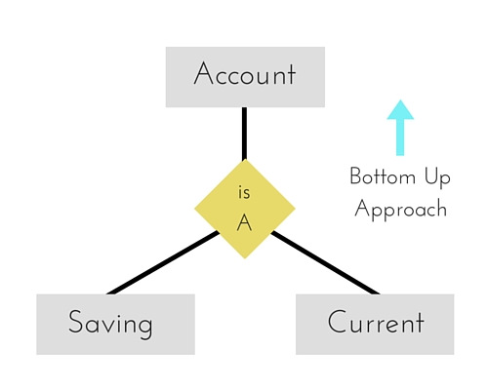
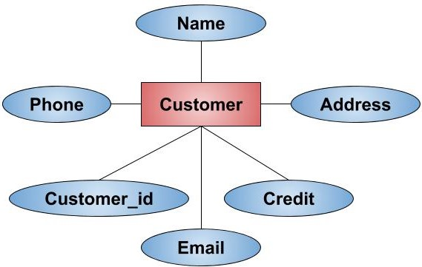
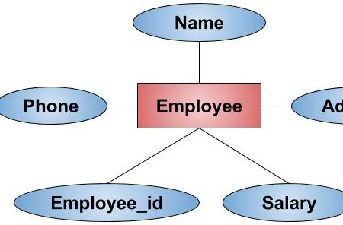
The Enhanced ER Model
Generalization is a bottom-up approach in which two lower level entities combine to form a higher level entity.
Generalization is the process of extracting common properties from a set of entities and create a generalized entity from it
The new entity type formed is called a generalized entity.
For example, Whales, Sharks, and Dolphins can be generalized as Fish
Similarly, Bicycle, Bike, and Car can be generalized as Vehicles.
It's more like Superclass and Subclass system

Slide 61

generalization

Slide 62

specialization
Specialization is opposite to Generalization.
It is a top-down approach in which one higher level entity can be broken down into two lower level entity.
For Example, EMPLOYEE entity in an Employee management system can be specialized into DEVELOPER, TESTER etc.
In this case, common attributes like E_NAME, E_SAL etc. become part of higher entity (EMPLOYEE) and specialized attributes like TES_TYPE become part of specialized entity (TESTER).

Slide 63

aggregation
Aggregation is a process when relation between two entities is treated as a single entity.
In the diagram above, the relationship between Center and Course together, is acting as an Entity, which is in relationship with another entity Visitor.
Now in real world, if a Visitor or a Student visits a Coaching Center, he/she will never enquire about the center only or just about the course, rather he/she will ask enquire about both.

Slide 64
PROBLEM
The Scenario: A University contains many Faculties. The Faculties in turn are divided into several Schools. Each School offers numerous programs and each program contains many courses. Lecturers can teach many different courses and even the same course numerous times. Courses can also be taught by many lecturers. A student is enrolled in only one program but a program can contain many students. Students can be enrolled in many courses at the same time and the courses have many students enrolled.

Slide 65


ATTRIBUTE IN RELATIONSHIP Give attributes to a relationship only in the case of many to many relationship.
For example, in this very simple ERD we have a Runner running a Race. And we know that we want to track when that runner started the race. In that case we’d need an attribute on the relationship since the StartTime would be tied to both the specific runner and the specific race they were running

Slide 66
PROBLEM
Draw an ER diagram for the given scenario;
Suppose that you are designing a schema to record information about reality shows on TV. Your database needs to record the following information:
_ For each reality show, its name, genre, basic_info and participants name. Any reality show has at least two or more participants.
_ For each producer, the company name, company country. A show is produced by exactly one producer. And one producer produces exactly one show.
_ For each television, its name, start year, head office. A television may broadcasts multiple shows. Each show is broadcasted by exactly one television.
_ For each user, his/her username, password, and age. A user may rate multiple shows, and a show may be rated by multiple users. Each rating has a score of 0 to 10.
Draw an entity relationship diagram for this database.

Slide 67

SOLUTION

Slide 68
PROBLEM
A company has several departments. Each department has a supervisor and at least one employee. Employees must be assigned to at least one, but possibly more departments. At least one employee is assigned to a project, but an employee may be on vacation and not assigned to any projects. The important data fields are the names of the departments, projects, supervisors and employees, as well as the supervisor and employee number and a unique project number.

Slide 69
Identify Entities
The entities in this system are Department, Employee, Supervisor and Project. One is tempted to make Company an entity, but it is a false entity because it has only one instance in this problem. True entities must have more than one instance.

Slide 70
Find Relationships We construct the following Entity Relationship Matrix:
We construct the following Entity Relationship Matrix:
 | Department | Employee | Supervisor | Project
Department |  | is assigned | run by
Employee | belongs to |  |  | works on
Supervisor | runs
Project |  | uses

Slide 71

Draw Rough ERD We connect the entities whenever a relationship is shown in the entity Relationship Matrix.

Slide 72
Fill in Cardinality
From the description of the problem we see that: Each department has exactly one supervisor.
A supervisor is incharge of one and only one department.
Each department is assigned at least one employee.
Each employee works for at least one department.
Each project has at least one employee working on it.
An employee is assigned to 0 or more projects.

Slide 73


Slide 74
ER PROBLEMS-CONNECTION PROBLEMS
Fan Trap. It occurs when a model represents a relationship between entity types, but pathway between certain entity occurrences is ambiguous. A fan trap may exist where two or more one-to-many (1:N) relationships fan out from the same entity
Chasm Trap. It occurs when a model suggests the existence of a relationship between entity types, but pathway does not exist between certain entity occurrences.

Slide 75
Relational model
In the relational model, all data is logically structured in relations.
Relational model can represent as a table with columns and rows. Each row is known as a tuple. Each table of the column has a name or attribute.
Domain: It contains a set of atomic values that an attribute can take.
Attribute: Attributes are the properties that define a relation. e.g.; ROLL_NO, NAME. Each attribute Ai must have a domain
Relation Schema: A relation schema represents name of the relation with its attributes. e.g.; STUDENT (ROLL_NO, NAME, ADDRESS, PHONE and AGE) is relation schema for STUDENT. If a schema has more than 1 relation, it is called Relational Schema.
Tuple: Each row in the relation is known as tuple
Relation Instance: The set of tuples of a relation at a particular instance of time is called as relation instance
Degree: The number of attributes in the relation is known as degree of the relation.
Cardinality: The number of tuples in a relation is known as cardinality.
NULL Values: The value which is not known or unavailable is called NULL value
Relation key − Each row has one or more attributes, known as relation key, which can identify the row in the relation (table) uniquely.

Slide 76

relation

Slide 77

RELATION

Slide 78
PROPERTIES OF RELATION
It has a name which is unique within the relational schema.
Each cell of a relation contains exactly one value.
Each attribute has a name.
Each tuple is unique.
The order of attributes is insignificant.
The order of tuples is insignificant.

Slide 79

METADATA
Metadata is simply data about data
It means it is a description and context of the data. It helps to organize, find and understand data

Slide 80
METADATA
As we create lots of tables, views, constraints, indexes etc in a database, it is difficult for any developer or user to remember all of them. If there is any change request to the table structure or if there is any issue with the existing design then the developer might not remember which table is for which purpose or which table contains which data, what is the domain of the columns or if there is any specific meaning to the value that has been entered to the column etc. Also, if there is any new designer handling the database, then it is necessary for him to understand the system thoroughly.
Hence, every database stores every information about its objects. These information can be itS structure, definition, purpose, storage, number of columns and records, dependencies, access rights, owner etc. Basically these are the useful information about the data in the database. They are also called as metadata.
These metadata are also stored as rows and columns of a table. Collection of these metadata is stored in the data dictionary or system catalog. Usually, system catalogs are accessed by the DBMS to perform various transactions and data dictionary has the user accessible views that are accessed by the developers/ designers/ users.

Slide 81

METADATA

Slide 82

METADATA

Slide 83
SCHEMA,INSTANCE
 | Schema | Instance
Definition | The overall logical design of the database. | The collection of information stored in the database at a particular moment.
Includes | Table names, column names, datatypes, and size of columns, various constraint at logical level. | Actual data or information stored in tables in form of different records.
Change | changes infrequently. | changes frequently.
Cause of change | insertion of tables or columns and change in datatype,size or constraints on any column. | insert, delete or update operation on data stored in database.
Analogy | variable declaration | value of the variable

Slide 84

Relational Integrity Constraints
Database integrity refers to the accuracy and consistency of stored data
Every relation has some conditions that must hold for it to be a valid relation
Integrity constraints are a set of rules. It is used to maintain the quality of information.
Integrity constraints ensure that the data insertion, updating, and other processes have to be performed in such a way that data integrity is not affected.
Thus, integrity constraint is used to guard against accidental damage to the database.

Slide 85

Domain constraints
Domain constraints can be defined as the definition of a valid set of values for an attribute.
The data type of domain includes string, character, integer, time, date, currency, etc. The value of the attribute must be available in the corresponding domain.
For example, age cannot be less than zero and telephone numbers cannot contain a digit outside 0-9

Slide 86

Entity integrity constraints
The entity integrity constraint states that primary key value can't be null.
This is because the primary key value is used to identify individual rows in relation and if the primary key has a null value, then we can't identify those rows.
A table can contain a null value other than the primary key field.

Slide 87

Key constraints
Keys are the entity set that is used to identify an entity within its entity set uniquely.
An entity set can have multiple keys, but out of which one key will be the primary key. A primary key can contain a unique and not null value in the relational table.

Slide 88

Referential Integrity Constraints
A referential integrity constraint is specified between two tables.
It states that if a foreign key exists in a relation then either the foreign key value must match a primary key value of some tuple in its home relation or the foreign key value must be null.
The rules are:
You can't delete a record from a primary table if matching records exist in a related table.
You can't change a primary key value in the primary table if that record has related records.
You can't enter a value in the foreign key field of the related table that doesn't exist in the primary key of the primary table.
However, you can enter a Null value in the foreign key, specifying that the records are unrelated.

Slide 89

Relational model languages
Relational database systems are expected to be equipped with a query language that can assist its users to query the database instances. There are two kinds of query languages − relational algebra and relational calculus.
Relational algebra is a procedural query language (WHAT+HOW), which takes instances of relations as input and yields instances of relations as output. It uses operators to perform queries. An operator can be either unary or binary

Slide 90
Selection operator (SIGMA OPERATOR)
Selection Operator (σ) is a unary operator in relational algebra that performs a selection operation.
It selects those rows or tuples from the relation that satisfies the selection condition.
Notation − σ_{p}(r)
It is denoted by sigma (σ).
Where:
σ is used for selection prediction r is used for relation p is used as a propositional logic formula which may use connectors like: AND (∧) OR (∨ ) and NOT (! ). These relational can use as relational operators like =, ≠, ≥, <, >, ≤.

Slide 91
Selection operator
Selection operator only selects the required tuples according to the selection condition
It does not display the selected tuples.
To display the selected tuples, projection operator is used.
Selection operator always selects the entire tuple. It can not select a section or part of a tuple.
Degree of the relation from a selection operation is same as degree of the input relation.
The number of rows returned by a selection operation is obviously less than or equal to the number of rows in the original table.

Slide 92
Selection-examples
Select tuples from a relation “Books” where subject is “database”
σ_{subject = “database”} (Books)
Select tuples from a relation “Books” where subject is “database” and price is “450”
σsubject = “database” ∧ price = “450” (Books)
Select tuples from a relation “Books” where subject is “database” and price is “450” or have a publication year after 2010
σsubject = “database” ∧ price = “450” ∨ year >”2010″ (Books)

Slide 93
Projection operator(PI OPERATOR)
This operation shows the list of those attributes that we wish to appear in the result. Rest of the attributes are eliminated from the table.
It is denoted by ∏.
Notation: ∏ A1, A2, An (r)
Where A1, A2, A3 is used as an attribute name of relation r.
Projection operator automatically removes all the duplicates while projecting the output relation.
So, cardinality of the original relation and output relation may or may not be same.
Selection Operator performs horizontal partitioning of the relation.
Projection operator performs vertical partitioning of the relation.

Slide 94
Projection-examples
Student
Result for Query π_{Name, Age}(Student)-
Name | Age
Ashish | 19
Rahul | 20
Naina | 20
Sameer | 21
ID | Name | Subject | Age
100 | Ashish | Maths | 19
200 | Rahul | Science | 20
300 | Naina | Physics | 20
400 | Sameer | Chemistry | 21
Result for Query π_{ID , Name}(Student)
ID | Name
100 | Ashish
200 | Rahul
300 | Naina
400 | Sameer

Slide 95
Union Operation
ID | Name | Subject
100 | Ankit | English
200 | Pooja | Maths
300 | Komal | Science
400 | Kajol | French
Let R and S be two relations.
Then- R ∪ S is the set of all tuples belonging to either R or S or both.
In R ∪ S, duplicates are automatically removed.
∏ author (Books) ∪ ∏ author (Articles)
Then, R ∪ S is-
ID | Name | Subject
100 | Ankit | English
200 | Pooja | Maths
300 | Komal | Science
ID | Name | Subject
100 | Ankit | English
400 | Kajol | French

Slide 96
Intersection Operator (∩)-
Let R and S be two relations.
Then-R ∩ S is the set of all tuples belonging to both R and S.
In R ∩ S, duplicates are automatically removed.
∏ CUSTOMER_NAME (BORROW) ∩ ∏ CUSTOMER_NAME (DEPOSITOR)
ID | Name | Subject
100 | Ankit | English
200 | Pooja | Maths
300 | Komal | Science
ID | Name | Subject
100 | Ankit | English
400 | Kajol | French
ID | Name | Subject
100 | Ankit | English
Then, R ∩ S is-

Slide 97
Difference Operator (-)
Let R and S be two relations.
Then-R – S is the set of all tuples belonging to R and not to S.
In R – S, duplicates are automatically removed.
∏ CUSTOMER_NAME (BORROW) - ∏ CUSTOMER_NAME (DEPOSITOR)
ID | Name | Subject
100 | Ankit | English
200 | Pooja | Maths
300 | Komal | Science
ID | Name | Subject
100 | Ankit | English
400 | Kajol | French
ID | Name | Subject
200 | Pooja | Maths
300 | Komal | Science
Then, R – S is-

Slide 98
Cartesian product
The Cartesian product is used to combine each row in one table with each row in the other table. It is also known as a cross product.
It is denoted by X.
EMP_ID | EMP_NAME | EMP_DEPT | DEPT_NO | DEPT_NAME
1 | Smith | A | A | Marketing
1 | Smith | A | B | Sales
1 | Smith | A | C | Legal
2 | Harry | C | A | Marketing
2 | Harry | C | B | Sales
2 | Harry | C | C | Legal
3 | John | B | A | Marketing
3 | John | B | B | Sales
3 | John | B | C | Legal
EMP_ID | EMP_NAME | EMP_DEPT
1 | Smith | A
2 | Harry | C
3 | John | B
DEPT_NO | DEPT_NAME
A | Marketing
B | Sales
C | Legal
EMPLOYEE X DEPARTMENT

Slide 99
Rename Operation:
The rename operation is used to rename the output relation. It is denoted by rho (ρ).
Notation − ρ _{x} (E)
Where the result of expression E is saved with name of x.

Slide 100
Join Operations
Table A |  |  | Table B
column 1 | column 2 |  | column 1 | column 2
1 | 1 |  | 1 | 1
1 | 2 |  | 1 | 3
Inner Joins:
Theta join
EQUI join
Natural join
Outer join:
Left Outer Join
Right Outer Join
Full Outer Join
A ⋈ A.column 2 > B.column 2 (B)
column 1 | column 2
1 | 2
Theta join
A ⋈ A.column 2 = B.column 2 (B)
column 1 | column 2
1 | 1
EQUI join

Slide 101
Join operations
A ⋈ B
Num | Cube | Square
2 | 8 | 4
3 | 18 | 9
5 | 75 | -
Num | Square | Cube
2 | 4 | 4
3 | 9 | 9
4 | 16 | -
A
Num | Square
2 | 4
3 | 9
4 | 16
B
Num | Cube
2 | 8
3 | 18
5 | 75
Left Outer Join(A B)
Right Outer Join: ( A B )
A ⋈ B
Num | Cube | Square
2 | 4 | 8
3 | 9 | 18
4 | 16 | -
5 | - | 75

Slide 102
Relational alzebra
Question:
Consider the following relational database schema consisting of the four relation schemas:
passenger ( pid, pname, pgender, pcity)
agency ( aid, aname, acity)
flight (fid, fdate, time, src, dest)
booking (pid, aid, fid, fdate)
Answer the following questions using relational algebra queries;

Slide 103
Get the complete details of all flights to New Delhi.
σ _{desti= “New Delhi”} (flight)
Get the details about all flights from Chennai to New Delhi.
σ src = “Chennai” ^ dest = “New Delhi” (flight)
Find only the flight numbers for passenger with pid 123 for flights to Chennai before 06/11/2020.
Π _{fid} (σ _{pid = 123} (booking) ⨝ σ dest = “Chennai” ^ fdate < 06/11/2020 (flight))
Find the passenger names for passengers who have bookings on at least one flight.
Π _{pname} (passenger ⨝ booking)
Find the passenger names for those who do not have any bookings in any flights.
Π _{pname} ((Π _{pid} (passenger) - Π _{pid} (booking)) ⨝ passenger)
Find the agency names for agencies that located in the same city as passenger with passenger id 123.
Π _{aname} (agency ⨝ _{acity = pcity} (σ _{pid = 123} (passenger)))

Slide 104
Get the details of flights that are scheduled on both dates 01/12/2020 and 02/12/2020 at 16:00 hours.
(σ fdate = 01/12/2020 ^ time = 16:00 (flight)) ∩ (σ fdate = 02/12/2020 ^ time = 16:00 (flight))
Get the details of flights that are scheduled on either of the dates 01/12/2020 or 02/12/2020 or both at 16:00 hours.
(σ fdate = 01/12/2020 ^ time = 16:00 (flight)) ∪ (σ fdate = 02/12/2020 ^ time = 16:00 (flight))
Find the agency names for agencies who do not have any bookings for passenger with id 123.
Π _{aname} (agency ⨝ (Π _{aid} (agency) – Π _{aid} (σ _{pid = 123}(booking)))
Find the details of all male passengers who are associated with Jet agency.
Π _{passengers.pid, pname, pcity} (σ _{pgender = “Male”} (passengers ⨝ booking ⨝ agency))

Slide 105

Relational Calculus
Relational calculus is a non-procedural query language. In the non-procedural query language, the user is concerned with the details of how to obtain the end results
The relational calculus tells what to do but never explains how to do.

Slide 106
Tuple Relational Calculus (TRC)
The tuple relational calculus is specified to select the tuples in a relation. In TRC, filtering variable uses the tuples of a relation.
The result of the relation can have one or more tuples.
Notation:{T | P (T)} or {T | Condition (T)}
Where
T is the resulting tuples
P(T) is the condition used to fetch T.
For example:
{ T.name | Author(T) AND T.article = 'database' }
OUTPUT: This query selects the tuples from the AUTHOR relation. It returns a tuple with 'name' from Author who has written an article on 'database'.

Slide 107
Domain Relational Calculus (DRC)
The second form of relation is known as Domain relational calculus. In domain relational calculus, filtering variable uses the domain of attributes.
Domain relational calculus uses the same operators as tuple calculus. It uses logical connectives ∧ (and), ∨ (or) and ┓ (not)
It uses Existential (∃) and Universal Quantifiers (∀) to bind the variable.
Notation:
{ a1, a2, a3, ..., an | P (a1, a2, a3, ... ,an)}
Where
a1, a2 are attributes P stands for formula built by inner attributes
For example:
{< article, page, subject > | ∈ javatpoint ∧ subject = 'database'}
Output: This query will yield the article, page, and subject from the relational javatpoint, where the subject is a database.

Slide 108

Reduction of ER diagram to Table
Rule-01: For Strong Entity Set With Only Simple Attributes
A strong entity set with only simple attributes will require only one table in relational model.
Attributes of the table will be the attributes of the entity set.
The primary key of the table will be the key attribute of the entity set.
Roll_no | Name | Sex
Schema : Student ( Roll_no , Name , Sex )

Slide 109

Rule-02: For Strong Entity Set With Composite Attributes
A strong entity set with any number of composite attributes will require only one table in relational model.
While conversion, simple attributes of the composite attributes are taken into account and not the composite attribute itself.
Roll_no | First_name | Last_name | House_no | Street | City
Schema : Student ( Roll_no , First_name , Last_name , House_no , Street , City )

Slide 110

Rule-03: For Strong Entity Set With Multi Valued Attributes
A strong entity set with any number of multi valued attributes will require two tables in relational model.
One table will contain all the simple attributes with the primary key.
Other table will contain the primary key and all the multi valued attributes.
Roll_no | City |  | Roll_no | Mobile_no

Slide 111

For Binary Relationship With Cardinality Ratio 1:1
Way-01:
AR ( a1 , a2 , b1 )
B ( b1 , b2 )
Way-02:
A ( a1 , a2 )
BR ( a1 , b1 , b2 )

Slide 112

For Binary Relationship With Cardinality Ratio m:1
Here, two tables will be required-
AR ( a1 , a2 , b1 )
B ( b1 , b2 )

Slide 113

For Binary Relationship With Cardinality Ratio 1:n
Here, two tables will be required-
A ( a1 , a2 )
BR ( a1 , b1 , b2 )

Slide 114

For Binary Relationship With Cardinality Ratio m:n
Here, three tables will be required-
A ( a1 , a2 )
R ( a1 , b1 )
B ( b1 , b2 )

Slide 115

For Binary Relationship With Cardinality Constraint and Total Participation Constraint From One Side
Because cardinality ratio = 1 : n , so we will combine the entity set B and relationship set R.
Then, two tables will be required-
A ( a1 , a2 )
BR ( a1 , b1 , b2 )
Because of total participation, foreign key a1 has acquired NOT NULL constraint, so it can’t be null now.

Slide 116

For Binary Relationship With Cardinality Constraint and Total Participation Constraint From Both Sides
Here, Only one table is required.
ARB ( a1 , a2 , b1 , b2 )

Slide 117

For Binary Relationship With Weak Entity Set-
Weak entity set always appears in association with identifying relationship with total participation constraint.
Here, two tables will be required-
A ( a1 , a2 )
BR ( a1 , b1 , b2 )

Slide 118

Emp_no | Dept_id | since

Slide 119

Include IID of Invention as the foreign key of Scientist
Scientist (SID, SName, RArea, Country, IID)
Invention (IID, IName, Year)
(OR)
Include SID of Scientist as the foreign key of Invention
Scientist (SID, SName, RArea, Country)
Invention (IID, IName, Year, SID)
Both are valid relational schemas.

Slide 120

Include SID of Scientist as the foreign key of Invention
Scientist (SID, SName, RArea, Country)
Invention (IID, IName, Year, SID)

Slide 121

Include IID of Invention as the foreign key of Scientist
Scientist (SID, SName, RArea, Country, IID)
Invention (IID, IName, Year)

Slide 122

Final relation schemas of the given ER diagram are as follows;
Scientist (SID, SName, RArea, Country,)
Invention (IID, IName, Year)
Invents (SID, IID)

Slide 123

Scientist (SID, FName, LName, Country)
Scientist_Area (SID, RArea)
Invention (IID, IName, Year)
Invents (SID, IID)

Slide 124

Customer (custID, lastName, firstName, street, city, state, zip, creditLimit, areaCode, number)
Order (orderNo, date, totalAmount, tax, street, city, state, zip, areaCode, number, custId)
Supplier (supplierNo, supName, street, city, state, zip, country, contactName, countryCode, areaCode, number)
Item (ItemNo, ItemName, unitPrice, qtyOnHand, reorderPoint)
Contains (orderNo, ItemNo, Quantity)
Supplies (supplierNo, ItemNo, unitCost)

Slide 125

Final relational schema after reduction is as follows;
Manufacturer (name, street, city)
Part (part_num, description, name)
Customer (ID, Name)
Order (order_num, ID, part_num, Quantity)
Contains (order_num, part_num, Quantity)

Slide 126


Slide 127
solution
Bank (B_id, B_name, B_add)
Customer (Cust_id, Cust_name, State, Country, Pin)
Customer_Phone (Cust_id, Ph_no)
Account (Acc_no, Acc_type, Balance)
ATM (ATM_id, cash_limit, location, B_id)
Branch (Br_id, Br_name, State, Country, Pin, B_id)
Transaction (Tr_id, Tr_type, Cust_id)
Operates (ATM_id, Cust_id)
Holds (Cust_id, Acc_no)

Slide 128


Slide 129
solution
Final set of relation schemas: (Primary keys are underlined)
STUDENT (Student_ID, Student_Name, DOB, Door, Street, City, Pin)
CLASS (Class_ID, Class_Name, Student_ID, DateOfJoin, Hours#)
SUBJECT (Subject_ID, Subject_Name, Teacher, Student_ID)
SECTION (Section_ID, Class_ID, Section_Name)

Slide 130

Solution-
Applying the rules, minimum 3 tables will be required-
MR1 (M1 , M2 , M3 , P1)
P (P1 , P2)
NR2 (P1 , N1 , N2)

Slide 131

Applying the rules, minimum 3 tables will be required-
E1 (a1 , a2)
E2R1R2 (b1 , b2 , a1 , c1 , b3)
E3 (c1 , c2)

Slide 132

Applying the rules, minimum 4 tables will be required-
AR1R2 (a1 , a2 , b1 , c1)
B (b1 , b2)
C (c1 , c2)
R3 (b1 , c1)

Slide 133

Applying the rules, minimum 5 tables will be required-
BR1R4R5 (b1 , b2 , a1 , c1 , d1)
A (a1 , a2)
R2 (a1 , c1)
CR3 (c1 , c2 , d1)
D (d1 , d2)

Slide 134

Applying the rules that we have learnt, minimum 6 tables will be required-
Account (Ac_no , Balance , b_name)
Branch (b_name , b_city , Assets)
Loan (L_no , Amt , b_name)
Borrower (C_name , L_no)
Customer (C_name , C_street , C_city)
Depositor (C_name , Ac_no)

Slide 135

Company( CompanyID , name , address )
Staff( StaffID , dob , address , WifeID)
Child( ChildID , name , StaffID )
Wife ( WifeID , name )
Phone(PhoneID , phoneNumber , StaffID)
Task ( TaskID , description)
Work(WorkID , CompanyID , StaffID , since )
Perform(PerformID , StaffID , TaskID )

Slide 136


Slide 137
solution
Driver(ID, Name, PhoneNo)
Truck(LicNo, maxVol, maxWt)
Trip(tripNo)
Shipment(ShipNo, Vol, Weight, tripNo)
Journey(ID, LicNo, tripNo)
SBetween(ShipNo, From_Address, Pickup_time, To_Address, Dropoff_time)
StopPoint(Address)
Warehouse(Address, port)
shopNpay(Address, openHrs)

Slide 138


Slide 139

solution

Slide 140
Functional Dependency-
relationship between attributes of a table dependent on each other
Introduced by E. F. Codd, it helps in preventing data redundancy and gets to know about bad designs.
Functional dependency is a relationship that exists when one attribute uniquely determines another attribute.
If R is a relation with attributes X and Y, a functional dependency between the attributes is represented as X->Y, which specifies Y is functionally dependent on X. Here X is a determinant set and Y is a dependent attribute. Each value of X is associated with precisely one Y value.
Each value of X is associated with precisely one Y value.
Assume we have an employee table with attributes: Emp_Id, Emp_Name, Emp_Address.
Here Emp_Id attribute can uniquely identify the Emp_Name attribute of employee table because if we know the Emp_Id, we can tell that employee name associated with it.
Functional dependency can be written as:
Emp_Id → Emp_Name
We can say that Emp_Name is functionally dependent on Emp_Id.
The EmpId identifies the employee specifically, but EmpName cannot distinguish the EmpId because more than one employee could have the same name.

Slide 141
Functional Dependence - 1
A → B
This is the notation
If we know the value of A then we will know the value of B

Slide 142
fd
Within a relation, if it is said that ‘a determines b’ then this means if you know the value of a , then you will know the value of b. so a functionally determines b. or b is functionally dependent on a. note that reverse is not true.
Representions :a->b
Examples: studentid->studentname
If you know the studentid, then you will know the studentname. But the reverse is not true, because we might have students who have the same name.

Slide 143
Functional Dependence - 2
StudentID → StudentName
StudentID | StudentName
23 | Singh
34 | Smith
56 | Smith
76 | Singh

Slide 144

Fd example
FD1 : Roll_No ->Name
FD2 : Roll_No ->Marks

Slide 145
FD
Regno | Name | DOB | Phone | Gender | CID | CName | Ins_ID | Ins_Name | Ins_Office
14M01 | Kumar | 12-Jan-1996 | 12345 | M | C1 | DBMS | I1 | Kesav | G123
14M05 | Mary | 10-Jun-1995 | 12367 | F | C1 | DBMS | I1 | Kesav | G123
14M07 | Ram | 10-May-1996 | 12898 | M | C1 | DBMS | I2 | Ragav | G127
14M01 | Kumar | 12-Jan-1996 | 12345 | M | C3 | DS | I5 | Mani | G125
14B01 | Revathi | 10-Dec-1995 | 23456 | F | C3 | DS | I5 | Mani | G125
14M09 | Steve | 23-Oct-1995 | 34567 | M | C4 | OS | I5 | Mani | G125
14B03 | Ramya | 20-Jul-1996 | 23456 | F | C4 | OS | I5 | Mani | G125
Regno → Name, DOB, Phone, Gender
CID → CName
CName → CID
Ins_ID → Ins_Name, Ins_Office
Regno,CID → Name, DOB, Phone, Gender, CName
Phone → Regno
CID → Ins_ID

Slide 146

FD
Trivial Functional Dependencies-
A functional dependency X → Y is said to be trivial if and only if Y ⊆ X.
The examples of trivial functional dependencies are-
AB → A
AB → B
AB → AB
Non-Trivial Functional Dependencies
A functional dependency X → Y is said to be non-trivial if and only if Y ⊄ X.
The examples of non-trivial functional dependencies are-
AB → BC
AB → CD
When A intersection B is NULL, then A → B is called as complete non-trivial.

Slide 147
Inference Rule (IR)
The Armstrong's axioms are the basic inference rule.
Using the inference rule, we can derive additional functional dependency from the initial set.
1. Reflexive Rule (IR₁)
If X ⊇ Y then X → Y
2. Augmentation Rule (IR₂)
If X → Y then XZ → YZ
3. Transitive Rule (IR₃)
If X → Y and Y → Z then X → Z
4. Union Rule (IR₄)
If X → Y and X → Z then X → YZ
5. Decomposition Rule (IR₅)
If X → YZ then X → Y and X → Z
6. Pseudo transitive Rule (IR₆)
If X → Y and YZ → W then XZ → W

Slide 148
ATTRIBUTE CLOSURE
The set of attributes that are functionally dependent on the attribute A is called Attribute Closure of A and it can be represented as A⁺.
The set of all those attributes which can be functionally determined from an attribute set is called as a closure of that attribute set.
Given a set F of FDs, and a set X of attributes, the closure set of X (w.r.t F), denoted X+ , is the set of all attributes that can be inferred to be functionally dependant on X. Surely X is a subset of X+ .
For example, if F={ a→b, b→c }, then {a}+ ={a,b,c} .
To find the closure set X+, we can use the simple steps below: 1) Initially X+=X 2) For each FD in F, if the LHS is in X+, add the RHS to X+ 3) Repeat until no change to X+ is possible

Slide 149
Consider a relation R ( A , B , C , D , E , F , G ) with the functional dependencies-
A → BC
BC → DE
D → F
CF → G
Closure of attribute A-
A⁺ = { A }
= { A , B , C } ( Using A → BC )
= { A , B , C , D , E } ( Using BC → DE )
= { A , B , C , D , E , F } ( Using D → F )
= { A , B , C , D , E , F , G } ( Using CF → G )
Thus,
A⁺ = { A , B , C , D , E , F , G }

Slide 150
D⁺ = { D , F }
Closure of attribute set {B, C}-
{ B , C }⁺= { B , C }
= { B , C , D , E } ( Using BC → DE )
= { B , C , D , E , F } ( Using D → F )
= { B , C , D , E , F , G } ( Using CF → G )
Thus,
{ B , C }⁺ = { B , C , D , E , F , G }
If the closure result of an attribute set contains all the attributes of the relation, then that attribute set is called as a super key of that relation.
If there exists no subset of an attribute set whose closure contains all the attributes of the relation, then that attribute set is called as a candidate key of that relation.
A is also a SUPER/candidate key for that relation.

Slide 151
Problem-
Consider the given functional dependencies-
AB → CD
AF → D
DE → F
C → G
F → E
G → A
Which of the following options is false?
(A) { CF }⁺ = { A , C , D , E , F , G }
(B) { BG }⁺ = { A , B , C , D , G }
(C) { AF }⁺ = { A , C , D , E , F , G }
(D) { AB }⁺ = { A , C , D , F ,G }
{ CF }⁺ = { C , F }
= { C , F , G } ( Using C → G )
= { C , E , F , G } ( Using F → E )
= { A , C , E , E , F } ( Using G → A )
= { A , C , D , E , F , G } ( Using AF → D )
{ BG }⁺ = { B , G }
= { A , B , G } ( Using G → A )
= { A , B , C , D , G } ( Using AB → CD )
{ AF }⁺ = { A , F }
= { A , D , F } ( Using AF → D )
= { A , D , E , F } ( Using F → E )
{ AB }⁺ = { A , B }
= { A , B , C , D } ( Using AB → CD )
= { A , B , C , D , G } ( Using C → G )

Slide 152
Consider the table student_details having (Roll_No, Name,Marks, Location) as the attributes and having two functional dependencies.
FD1 : Roll_No ->Name, Marks
FD2 : Name ->Marks, Location
{Roll_no}⁺ = {Roll_No, Marks, Name, Location}
{Name}⁺ = {Name, Marks, Location}
{Marks}⁺ = {Marks}
{Location}⁺ = { Location}

Slide 153
Closure of Functional Dependencies
"The closure of F, denoted as F+, is the set of all regular Functional Dependencies that can be derived from F".
Example: Consider relation E = (P, Q, R, S, T, U) having set of Functional Dependencies (FD).
P → Q P → R QR → S Q → T QR → U PR → U
Calculate some members of Axioms are as follows,
1. P → T 2. PR → S 3. QR → SU 4. PR → SU

Slide 154
Relationship between FDs and keys in a relation
A set X of attributes in R is a superkey of R if and only if X+ contains all attributes of R. In other words, X is a superkey if and only if it determines all other attributes.
X is a candidate key if and only if it is a superkey, but none of its proper subset is a superkey
However, the candidate keys can be found more efficiently, using the observations below: Observation 1: any candidate key must contain attributes that have not appeared on the RHS of any functional dependency. Observation 2: if an attributed has occurred on the RHS of some FD, but not on the LHS of any FD, then it cannot be in any candidate key

Slide 155
R =(a,b,c,d,e) F={ a→c; c, d →b} The set of attribute not occurred on the RHS of any FD is {a, d, e}. Since the closure set of {a,d,e} contains all attributes of R, it is the only candidate key of R.
Consider the relation R(A,B,C) with given functional dependencies :
FD1 : A ->B
FD2 : B ->C
Clearly, “A” is the candidate key as, its closure contains all the attributes present in the relation “R”.
Consider another relation R(A, B, C, D, E) having the Functional dependencies :
FD1 : A ->BC
FD2 : C ->B
FD3 : D ->E
FD4 : E ->D
Hence, "AD" and "AE" are the two possible keys of the given relation “R”.
Prime Attributes : Attributes which are indispensable part of candidate keys. For example : “A, D, E” attributes are prime attributes in above example-2.
Non-Prime Attributes : Attributes other than prime attributes which does not take part in formation of candidate keys. For example.

Slide 156
Keys in relational model
student_id | name | phone | age
1 | Akon | 9876723452 | 17
2 | Akon | 9991165674 | 19
3 | Bkon | 7898756543 | 18
4 | Ckon | 8987867898 | 19
5 | Dkon | 9990080080 | 17
Keys play an important role in the relational database.
It is used to uniquely identify any record or row of data from the table. It is also used to establish and identify relationships between tables.

Slide 157
Keys in relational model
Super Key
Super Key is defined as a set of attributes within a table that can uniquely identify each record within a table. Super Key is a superset of Candidate key.
In the table defined above super key would include student_id, (student_id, name), phone etc.
Confused? The first one is pretty simple as student_id is unique for every row of data, hence it can be used to identity each row uniquely.
Next comes, (student_id, name), now name of two students can be same, but their student_id can't be same hence this combination can also be a key.
Similarly, phone number for every student will be unique, hence again, phone can also be a key.
So they all are super keys.
Super Key is an attribute (or set of attributes) that is used to uniquely identifies all attributes in a relation.
All super keys can’t be candidate keys but its reverse is true.

Slide 158
Keys in relational model
Candidate key
A set of minimal attribute(s) that can identify each tuple uniquely in the given relation is called as a candidate key.
A minimal super key is called as a candidate key.
There can be more than one candidate key.
In our example, student_Id and phone both are candidate keys for table student
Those attributes which appears in some candidate key are called as prime attributes.
The value of candidate key must always be unique.
The value of candidate key can never be NULL.

Slide 159
Keys in relational model
Primary key is a candidate key that is most appropriate to become the main key for any table. It is a key that can uniquely identify each record in a table.
A primary key is a candidate key that the database designer selects while designing the database.
The value of primary key can never be NULL.
The value of primary key must always be unique.
A relation is allowed to have only one primary key.
Candidate keys that are left unimplemented or unused after implementing the primary key are called as alternate keys.
From previous table, we can take student_id as primary key

Slide 160
Foreign key
Foreign key references the primary key of the table.
It is the attribute(s) that refers to the primary key of same or another table
Foreign key can take only those values which are present in the primary key of the referenced relation.
Foreign key may have a name other than that of a primary key.
Foreign key can take the NULL value.
There is no restriction on a foreign key to be unique.
In fact, foreign key is not unique most of the time.
Referenced relation may also be called as the master table or primary table.
Referencing relation may also be called as the foreign table.

Slide 161

Foreign key (IT MAINTAINS REFERENCIAL INTEGRITY)
Foreign keys are the column of the table which is used to point to the primary key of another table.
The relation in which attribute foreign key is present is called as the referencing relation.
Here, the relation in which attribute primary key is present is called as the referenced relation.
Foreign key might be present in the same table or in some other table.
In a company, every employee works in a specific department, and employee and department are two different entities. So we can't store the information of the department in the employee table. That's why we link these two tables through the primary key of one table.
We add the primary key of the DEPARTMENT table, Department_Id as a new attribute in the EMPLOYEE table.
Now in the EMPLOYEE table, Department_Id is the foreign key, and both the tables are related.

